Slide 1

Algorithms and Programming Languages
Microsoft Philanthropies TEALS Program
Introduction to Computer Science

Slide 2
Algorithms and Programming Languages
After this lesson, you will be able to...
Define Algorithm
Understand how to construct algorithms for performing simple tasks
Understand what a Programming Language is
Understand what SNAP! is and how to set up your SNAP! account

Slide 3
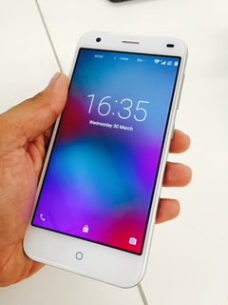
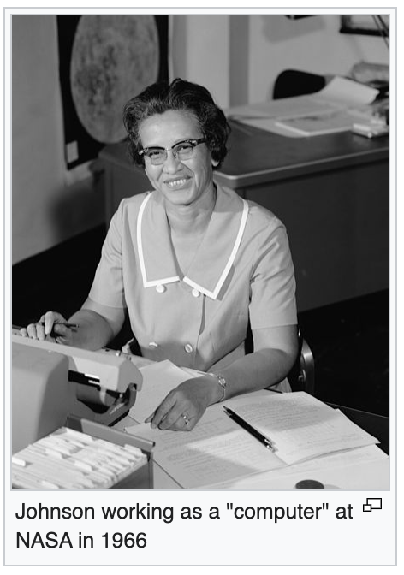
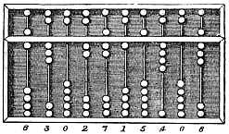

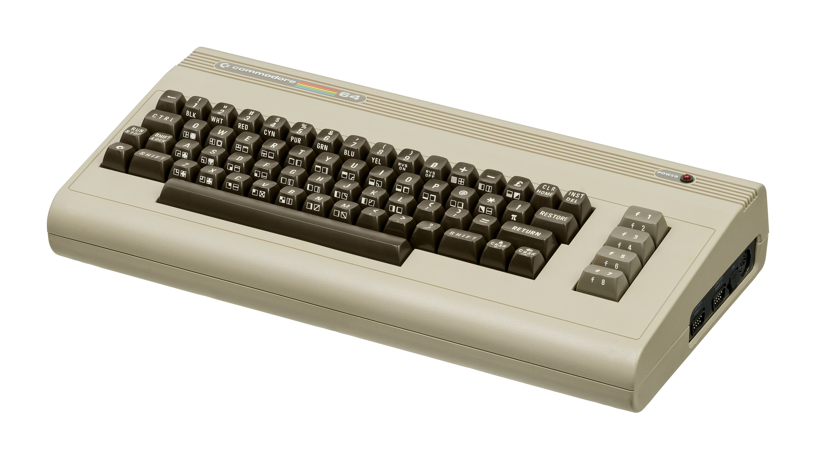
Introductory Discussion
What do these words mean to you?
  computer
  computer science
  algorithm
  program
  programming language
Notes:
- Invite discussion about what constitutes a computer, what computers do, and what computer science is.
- An excellent protocol for these types of discussions is "Chalk Talk" or "World Cafe"
- Develop definitions for important terms ("computer," "computer science," "algorithm," "program," "programming language")
- Display each term on the board or projector and ask students to provide key ideas or concepts they know that relate to the term. From this, you can develop a classroom definition. Feel free to have a pre-written definition and guide students to that definition using leading questions. Sample definitions:
Computer: An electronic machine that can solve different problems, process data, store & retrieve data and perform calculations.
Computer Science: The study of the principles and use of computers.
Algorithm: A complete, well-defined sequence of steps for completing a task or solving a problem.
Computer Program: A sequence of instructions or steps, written in a language that can be understood by a computer, that will be used by the computer to complete a task or solve a problem.
Programming Language: A vocabulary and set of grammatical rules for instructing a computer or computing device to perform specific tasks.
- You can introduce the idea that the first computers were human (a person who makes calculations, especially with a calculating machine) with the story about Katherine Johnson whose calculations were used for manned and unmanned orbital missions

Slide 4
What is an Algorithm?
An algorithm is a complete, well-defined sequence of steps for completing a task or solving a problem
Notes:
Suggested videos:
Unplugged - Real-Life Algorithms - Planting a Seed (Code.org): https://www.youtube.com/watch?v=FHsuEh1kJ18
What is an algorithm? Lesson by BJC Lecture 6: Algorithm (with Luke Segar)
Algorithm definition | 3:20-4:20
https://www.youtube.com/watch?v=3tvbqdLjjSU&t=3m20s

Slide 5
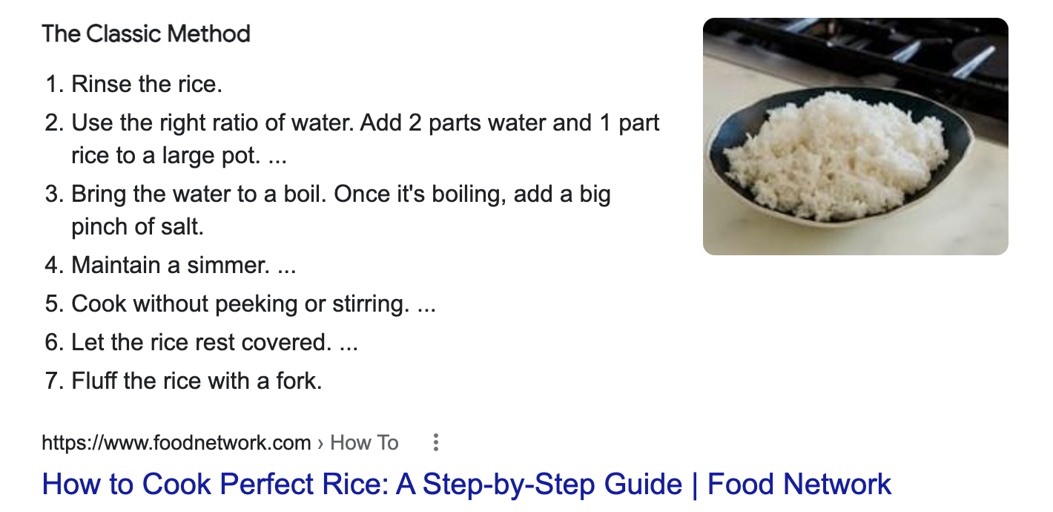
Examples of Algorithms: Cooking Rice

Slide 6
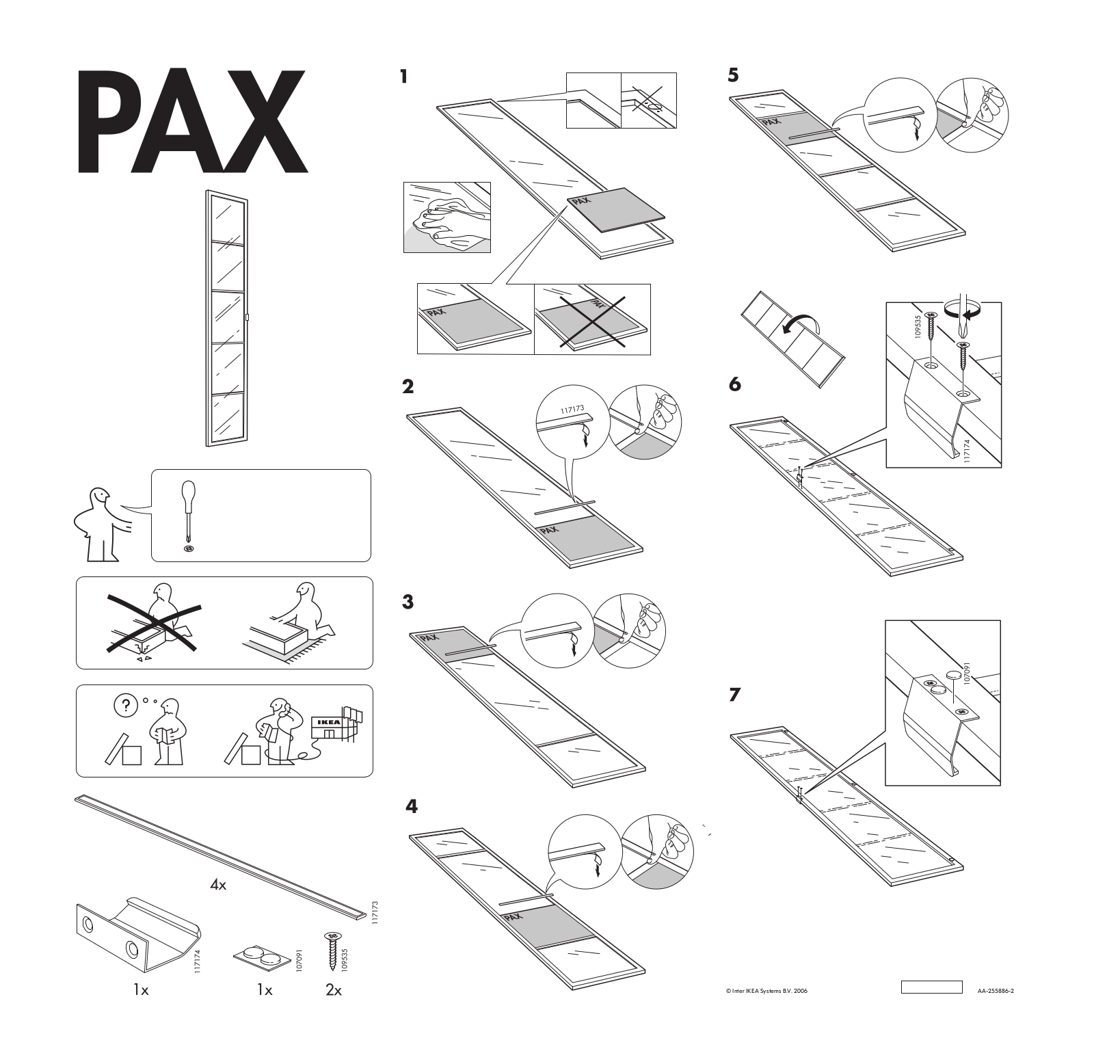
Examples of Algorithms: Ikea Assembly Instructions

Slide 7
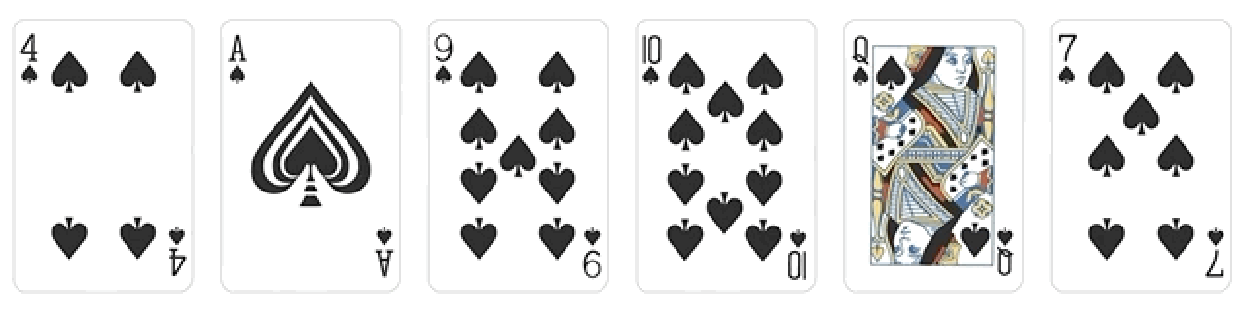
Examples of Algorithms: Sorting Playing Cards

Slide 8
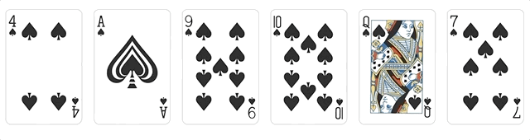
Examples of Algorithms: Sorting Playing Cards
Bubblesort:
Step 1: Moving from left two right, pick two cards at a time.
Step 2: Swap them if they are out of order.
Step 3: Do many passes until all cards are sorted.
Notes:
Source: https://marvinpdroid.medium.com/sort-like-a-boss-80ee71fc88e5

Slide 9



Introduction to Programming Languages
Computer program: a sequence of instructions or steps, written in a language that can be understood by a computer, that will be used by the computer to complete a task or solve a problem
Are there any programming languages that you have heard of?
Notes:
Computer program: a sequence of instructions or steps, written in a language that can be understood by a computer, that will be used by the computer to complete a task or solve a problem
Ask for any programming languages students are familiar with (even just names).
Draw distinctions between proper programming languages and other types of languages (such as markup languages e.g. HTML).
Sample video about programming languages: https://www.youtube.com/watch?v=6qF3HmRzg8o (Credit: William Masse)

Slide 10
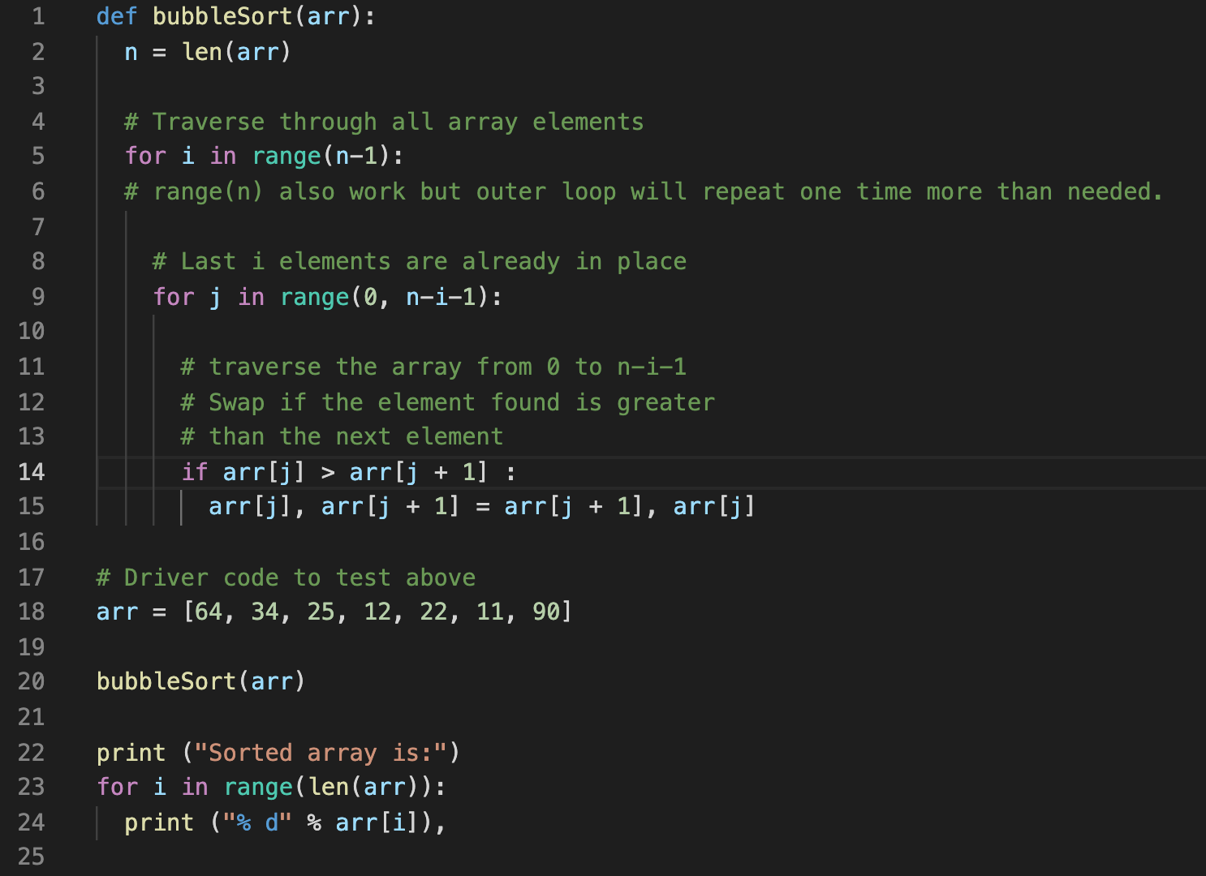
Bubblesort in Python

Slide 11
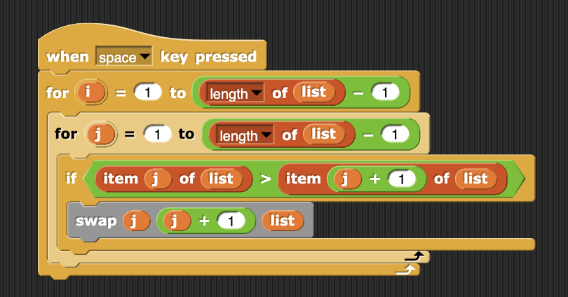
Bubblesort in Python and SNAP!

